Slide 1
SE.COM
Discovery Stage Playback
Research and Design
March 30th 2018

Slide 2
Research Approach
Purpose
To improve the understanding of what customers want from the online domestic channel
To test the strategic design principles
To perform usability testing on the domestic website wireframe prototype, to validate initial concepts for future state layout/design.
To inform the next design iteration
Location
Taylor McKenzie test lab in Glasgow (6th, 14th & 29th March)
Customer Profile:
Scottish companies, non retail, turnover > 500K and not currently receiving support from us
Sample
Number: 17 customers
Country: Scotland
Device: Desktop
Type: Face to Face testing

Slide 3
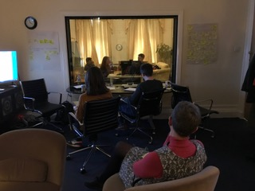
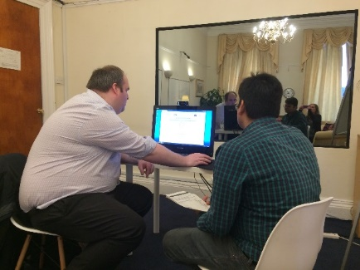
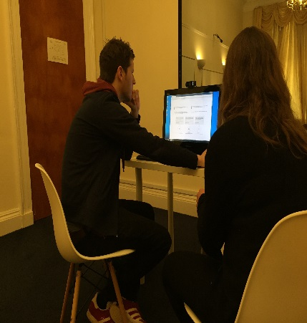
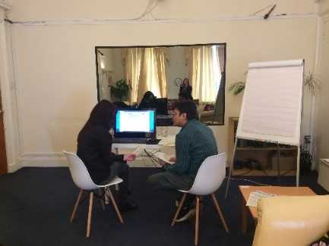
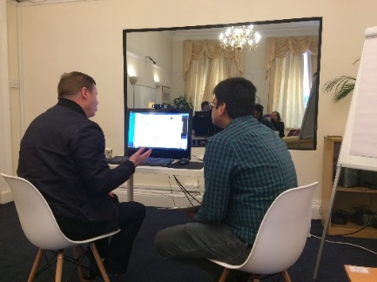
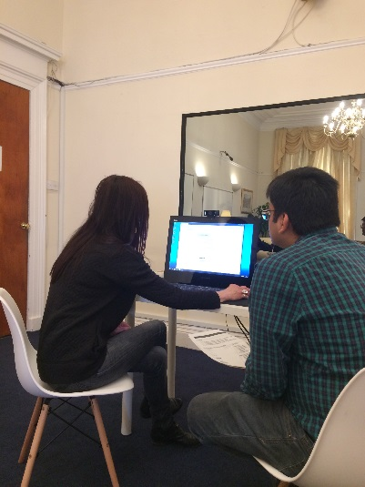
Quotes
I don’t want an account at this stage. I am only making an enquiry”
““I love things on the internet that are simple such as HMRC”
“FAQ’s were cool” in the live chat box.
““I am not in that category anymore so I am not sure how you can help me”
“I just wouldn’t scroll”
“The Stats look Great – are they real?”
“I would apply online as long as the form is not 10 pages long”

Slide 4
Initial Findings: Two Rounds of Testing
General
Customers confused where to go for the right information
Customers often unsure of which organisation they are dealing with
Customers unclear why they get grant/support rejected
Connect with Peers is redundant because of LinkedIn
A good navigation structure goes a long way
Avoid confusing overlaps in navigation options
One thing per page is a good adage once into the site
Requesting Customer Details
Don’t ask for too much information too early in the journey (eg high degree of surprise in asking for Companies House information). Less of an issue with Round 3
Belief that inputting details would result in “being marketed to”
Communication
Majority of users preferred telephone number to call if they got stuck
Live Chat mixed reviews
Businesses are interested in help from organisations (such as SE) BUT only if it is relevant to them
Information
Language needs to be clear
The journey to get to relevant information should be simple and quick
Large and impressive Stats are popular (but users questioned if they were real)
Information ”Below the Fold” remains a very real barrier to some users seeing the actual CTA’s
Content
Users expect most things to be clickable
Users expect interaction to be quick so indicated time it takes seen as irrelevant
The “Search Bar” was used as the preferred bailout method, when the user struggled to find what they were looking for. This was less of an issue with Round 3
Menu Options were well received (though sometimes missed initially)
Too much content not well received (eg Learning/Development section showcase because not relevant to them at this time)
Case Studies are good but need to be directed to me and my sector

Slide 5
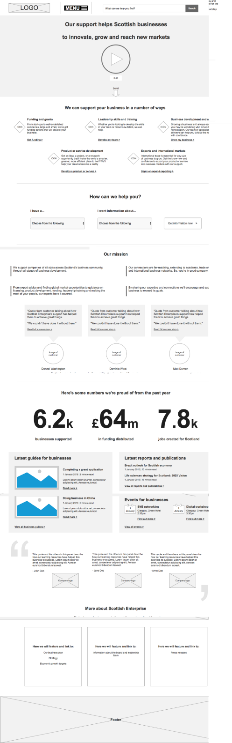
Research: Home page
☺
☹
Most people clicked on the video
“I Want To” menu was almost totally ignored
Most people gravitated towards this navigation
These statements got in the way of the next section
Less used than last time due to popularity of navigation
Not well understood or received.
The STAT’s were modestly well received, although authenticity was questioned
Mild praise but not warmly received. Viewed as potentially too generic by some
Modestly well received but too far bellow the fold
Most users viewed this as overkill on a home page

Slide 6
Hypothesis – Home page video
We thought that
Adding a short but descriptive video to the home page would enhance customers confidence in us and what we do.
To Verify this
We added a Video placeholder to the top of the Homepage Wireframe in all versions tested (Hero Slot)
We observed
Most people clicked on it. When it did not run they stated that they would have watched a short video.
From that we learned
People are willing to invest a short amount of time watching a Hero video
Recomendations
It is worth developing a short video around customer needs to trial on the live site

Slide 7
Mission & About Us

Slide 8
Hypothesis – Home Mission & About Us
We thought that
Adding sections describing our Mission and More About Us to the home page would make customers more confident in us and what we do
To Verify this
We added these sections to all versions of the SE.COM wireframes tested
We observed
They had the opposite effect on users than expected
From that we learned
Users become suspicious if we talk about ourselves too much. It looks like we are selling or pitching and this suggests that there is something lacking in us or that we are commercial in some way
Recomendations
Remove these sections from future home page designs

Slide 9
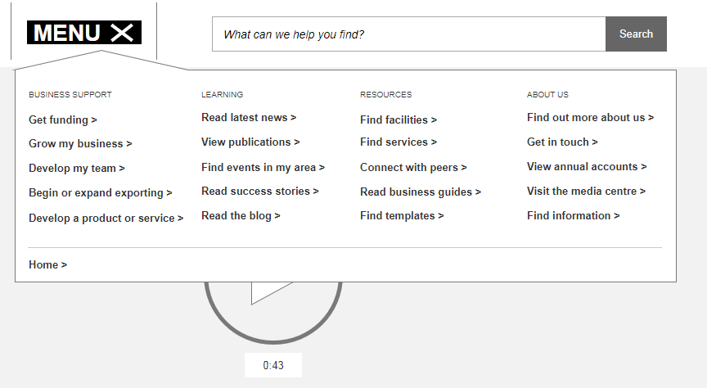
Connect to Peers

Slide 10
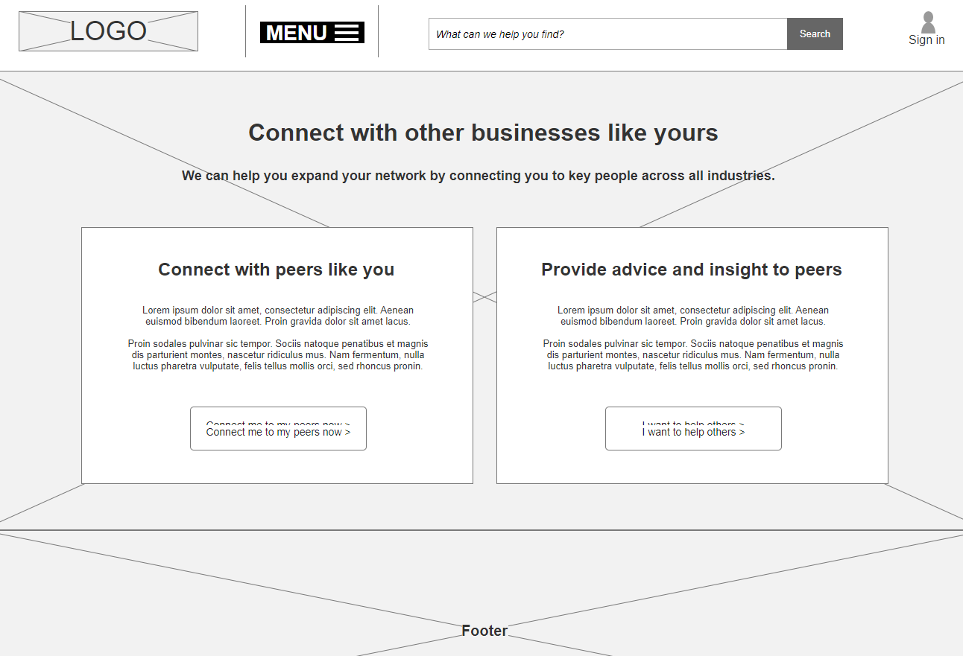
Connect to Peers

Slide 11
Hypothesis – Connect to Peers
We thought that
By offering a Connect to Peers section of the site that customers would use the opportunity to benefit from peers connections as well as help others.
To Verify this
We added a Connect to Peers section to the wireframe menu and ensured that all test participants viewed it
We observed
People were fairly negative about the idea and most stated that this is what they use LinkedIn for. They would also not expect Scottish Enterprise to get involved in this area and that it is a potential minefield.
From that we learned
People Use LinkedIn. They don’t need Scottish Enterprise to recreate LinkedIn on a smaller and more isolated manner.
Recomendations
Remove this facility from future designs
Investigate how using LinkedIn could have the desired effect

Slide 12


Recommendation: Home Page
Redesign Menu and Search box
Simplify
Homepage

Slide 13
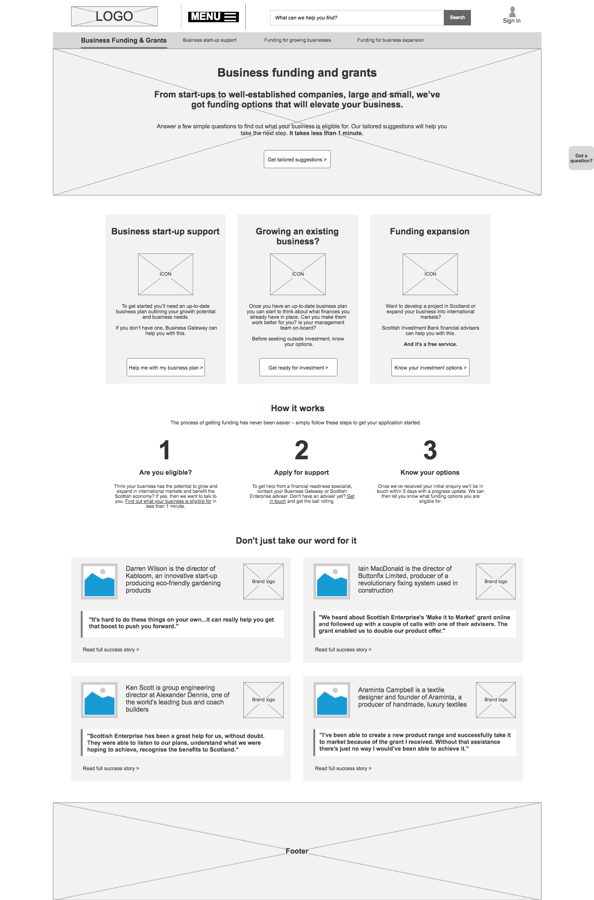
This page was well received
The tailoring options were widely used
This navigation options were clear and well received
Too much overlap between the 2nd and 3rd options
Warmly received but possibly too soon as they will not be relevant enough

Slide 15
This page was well received
The tailoring options were widely used
This navigation options were clear and well received
Too much overlap between the 2nd and 3rd options
Warmly received but possibly too soon as they will not be relevant enough

Slide 17
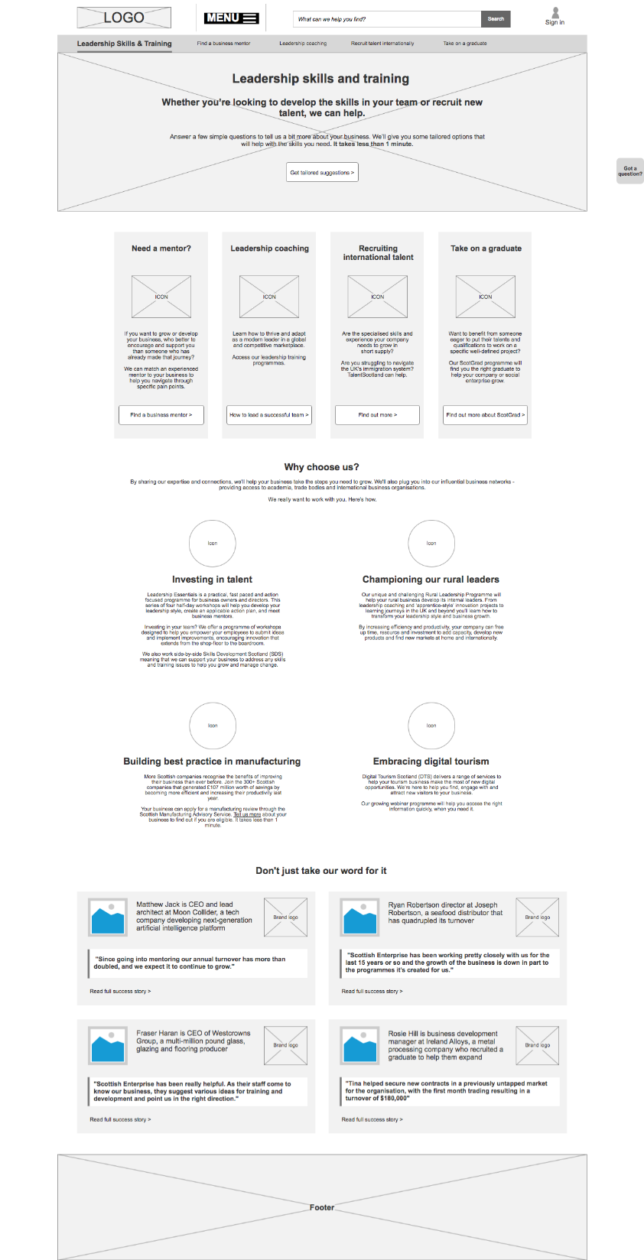
The tailoring options were widely used
Not what was expected and too confusing
This navigation options were clear and well received
Viewed as too generic and a bit desperate
Warmly received but possibly too soon as they will not be relevant enough

Slide 18


Slide 19
The tailoring options were widely used
Not what was expected and too confusing
This navigation options were clear and well received
Viewed as too generic and a bit desperate
Warmly received but possibly too soon as they will not be relevant enough

Slide 21
Next Steps
Research:
Two more user research sessions will be conducted as part of the Discovery Stage
Focus group session with Women Entrepreneurs, exploring their views on:
The role, formation and mobilisation of networks to help Scottish businesses scale and expand
Business support services required for exporting
Business support services required for trade
Focus group usability testing with Scottish companies that have an in-depth relationship with us and those who have used some of our services in the past
Concept Development:
At least one more revision will be made to the concept user experience design to aid with further research and the collation of insights.

